Slide 1

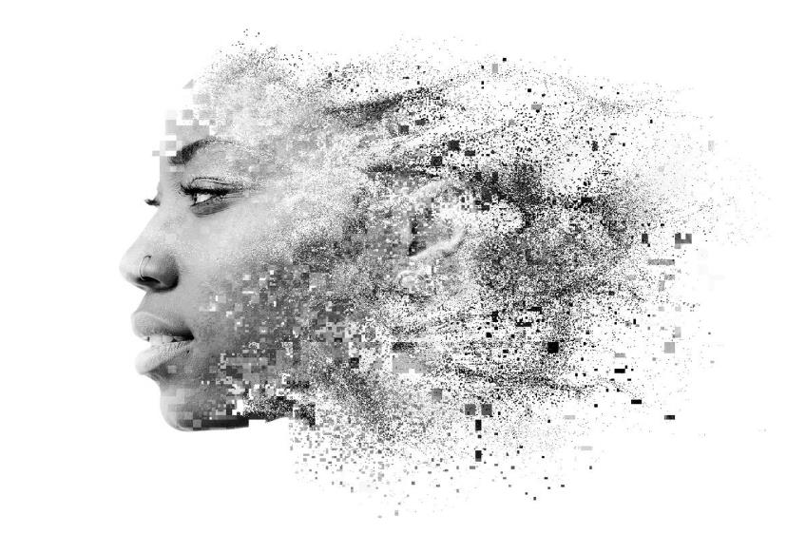




An Ethnographic exploration of South African women ages 14 – 25
Qualitative Report
December 2017

Slide 2
Deconstructing the business issue
Creating products to meet the personal care needs of young, low income women
How do we describe young, low income women?
2. What are their attitudes and beliefs, behaviours and interests?
3. How does being female impact their lives?
4. What products and brands do they use and what roles do they play in their individual and social identity?
5. What is the influence of social networks and influencers in the physical and digital world?
What are consumer profiles?
What are living circumstances and environment?
What are socio-economic influences?
What are their values, world view and beliefs?
What are their interests, hobbies, entertainment and activities?
What are their life goals and aspirations
What are their challenges, anxieties, hardships and concerns?
How do we frame psychological and socioeconomic characteristics to segment groups and personalise offerings?
What is their access to healthcare services, education and advice?
What access do they have to family planning?
What are their beliefs, values, anxieties, hopes concerning family planning?
What are their sexual attitudes and activity?
What feminine care products used, attitudes, awareness, concerns, sources of education, where sourced and what determines choice?
What are attitudes and perceptions of products and brands?
What is usage of personal care products?
Which are aspirational products and brands. Brand cues sought after?
How do we create products and messaging to address needs in the market?
What are Influences and Influencer groups for different products and categories, as well as behaviours?
What media channels consumed?
What is usage of digital products?
What is the role of social networks, mobile and face-to-face. What role does each play and what are influences?

Slide 3
Contents
1. | Introduction: Welcome to South Africa | 04
2. | Being Girl | 25
3. | Vulnerability | 43
3. | Womanhood and Sexual Autonomy | 54
4. | Category Attitudes & Behaviour | 94

Slide 4
Introduction
Welcome to South Africa

Slide 5
Multicultural, “rainbow” nation with diversity in terms of religion, ethnic make up and languages spoken, with women constituting ~52% of RSA’s population
Population Mix
Religion
Ethnic make-up
RSA is a secular democracy covering about 52 million people of different origins, cultures, languages, and religions and because of this diversity it is called the rainbow nation
The population slightly leans towards female population, 52% of the population consists of females compared to 48% males
RSA is traditionally a deeply religious country with high rates of participation in religious life among all groups
The population is overwhelmingly Christian(~70%, mostly protestants) with only very small Jewish, Muslim, and Hindu minorities
RSA’s population consists of various races with blacks constituting bulk of the population.
RSA has 11 official languages with English being the language of administration and is spoken throughout the country.
The other official languages are: Afrikaans, Ndebele, Northern Sotho, Southern Sotho, Swazi, Tsonga, Tswana, Venda, Xhosa and Zulu.
http://www.commisceo-global.com/country-guides/south-africa-guide
http://mobi.statssa.gov.za/census2011/Gender.html
http://www.everyculture.com/Sa-Th/South-Africa.html#ixzz3SWNTdW6K

Slide 6
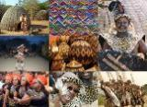
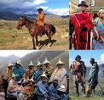
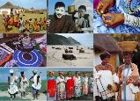
The society, however is patriarchal, which is seen across the “African” ethnic groups
Zulu culture
Sotho culture
Xhosa are the second largest cultural group in RSA, after the Zulus with wide variation in standards of living –
Xhosas make up some of the poorest and some of the wealthiest black Africans
While Xhosa culture remains patriarchal, there has been improved literacy rates amongst women, who now work in sectors like health care, education etc.
A culture, where men is considered head of the family
In modern society wives do have jobs outside the house. However, men still are expected to be the bread winners in the family.
The fact that women are coming out of their homes/ household work and work outside, shows that Zulu women are making a conscious effort in this direction
Sotho culture, another major African culture, is patriarchal at large
Traditionally, the man is considered the head of the household, while women are defined as bearers of children and work as farmers
Post apartheid era, health care, education, and government administration are popular careers for women, especially those with high school and college educations, in urban areas
Xhosa culture

Slide 7
All these cultures, are so deep rooted in tradition and beliefs, there is an inevitable clash of “Culture vs. Modernity”

Slide 8

A sustained system of patriarchy
Patriarchy is ingrained and to some extent fuelled by the incumbent dispensation. There is a gender crisis
Huge conflict between rights and culture

Slide 9
In this clash of traditions and modernity, cultures can’t be completely aloof; Women often bear the brunt of this churning
Inflammatory public statements by Zulu monarch King Goodwill Zwelithini and President Jacob Zuma fuelled the "prevailing atmosphere of fear" during last year's wave of xenophobic violence in KwaZulu-Natal
While the Special Reference Group(SRG) on Migration and Community Integration in KwaZulu-Natal found there was no direct link between comments Zwelithini made in March last year - that foreigners should leave South Africa - and the xenophobic attacks, but it identified statements from public figures as contributing to tensions between locals and foreign nationals.
Battle between South Africa’s traditionalist president and its modernist finance minister
Former Minister of Finance Nhlanhla Nene had focussed on governance in State Owned Enterprises and capital projects that were unaffordable for the country’s economy.
It is widely believed the action irked President Zuma - A younger “clever” and modern young black man had challenged an “elder” in the form of Zuma, which is traditionally unacceptable in the Zulu culture.
Case of traditional leadership & their power
Traditionalist President vs. Modernist FM
Ban on Afro Hair by girls in Pretoria school
Girls at the Pretoria Girls High school took it upon themselves to protest the policy, which implies that natural hair is “messy,” after the school reportedly used the policy to uphold one student’s suspension
The code of conduct was insensitive as it went against their tradition and was considered “racist” as well!
Notes:
http://theconversation.com/south-africas-traditionalist-president-versus-modernist-finance-minister-55391
http://www.timeslive.co.za/thetimes/2016/04/06/Zulu-kings-comments-fuelled-xenophobic-unease
http://www.sabc.co.za/news/a/2d6d9f804e5a877c8fdaffd55446c230/Education,-value-systems-define-SAs-heritage-20162409
http://nymag.com/thecut/2016/08/south-african-schoolgirls-protest-to-wear-natural-hair.html

Slide 10

Today the vast majority of South Africans are being raised in female-headed households without male input, guidance and role models
Female heads work long hours leaving children in care of grandmothers or without care
Female headed households and child headed households are more vulnerable to poverty (patriarchal influence)
Children now have greater levels of peer influence than in the past (lack the balance of peer and maternal/ paternal vs peer)
Female households greater poverty
Less
Generational
care
Greater
peer
influence
The apartheid legacy of separate development created a system of women and children confined to rural areas and men seeking work in urban areas.
Separate
Living
Misinformation
Greater misinformation
Notes:
In this clash of traditions and modernity, cultures can’t be completely aloof; Women often bear the brunt of this churning

Slide 11
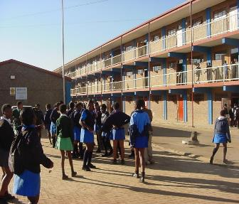
Women are economically marginalized and oppressed. A patriarchal society, where women continue to face barriers in education, occupation and prosperity
“Empowering women” and promoting “gender equality” is grounded in the institutional framework of South Africa with various legislations taken by the government:
The Children’s Act, 2005 and Children’s Amendment Act, 2007, Thuthuzela care centers, Women Empowerment and Gender Equality Bill, The Domestic Violence Act, 1998, National Council Against Gender Based Violence (NCAGBV),Prevention and Combating of Trafficking in Persons
National Action Plan
However, in spite of so many initiatives from the government and independent bodies, most of them failed to achieve the desired results, mainly due to lack of coordination and authority
Various factors - Economic, bi-constitutional, socio-cultural, health, racism, gender violence and teenage pregnancy prevent them from continuing their education journey
Educational quality and female access to education are still concerns, especially amongst black ethnic groups

Slide 12
Young women struggle to find a suitable environment for education due to various barriers
Bi-constitutional
barriers
Gender violence
Racism
Teenage pregnancy
Economic Barriers
Socio-cultural barriers
Health barriers
Family poverty
Unemployment
Food insecurity
Lack of proper infrastructure in the home and school such as safe toilets and sanitation
Lack of gender budgeting
Gender based curriculum
Pedagogy
Lack of integration in service delivery
Patriarchal society
Poor parenting
Mismatch between school and home teaching
Cultural factors – Initiation schools etc.
HIV and AIDS
Teenage fertility
Gendered burden of care in families and communities
More than 40% of the children had been the victim of crime at school in RSA
Young girls are particularly vulnerable to this
Racism is another challenged faced by young women
Ban of afro-hair in a prestigious school in Pretoria is a case in point
Between 2009-10, some 14,400 live births (could be an under claim as well) were recorded to young women between the ages of 12 and 19
Notes:
http://www.anc.org.za/docs/discus/2014/educationg.pdf
http://businesstech.co.za/news/lifestyle/135621/the-most-racist-provinces-in-south-africa/
https://www.theguardian.com/world/2016/aug/29/south-africa-pretoria-high-school-for-girls-afros
http://tbinternet.ohchr.org/Treaties/CEDAW/Shared%20Documents

Slide 13
Culturally diverse, patriarchal society. However, in this ever changing world, where there is often a clash of tradition & modernity, women often bear the brunt of this churning
Multicultural, “rainbow” nation with diversity in terms of religion, ethnic make up and languages spoken, with women constituting ~52% of the population
“African” population group constitutes ~75% of total population of RSA, with Zulu and Xhosa constituting the two largest ethnic African groups
Being culturally diverse with various ethnic groups, it is difficult to generalise the etiquettes/ customs and family system in RSA – Blacks, Whites, Coloured etc.
The society, however is patriarchal, which is seen across the “African” ethnic groups. While things are improving, men still are expected to be the bread winners in the family
In this constantly changing world, there would be a clash of tradition vs. modernity, which is what is happening. Women are bearing the brunt of this churning, due to patriarchal society
Women historically seen as doing household work or in farms, across African ethnic groups, with change in times, aspire to be treated equal with men and rightly so!

Slide 14

There is more to South Africa than the single story of poverty and patriarchy. Lets break some stereotypes and get a picture of the real life environments of young women in South Africa

Slide 15
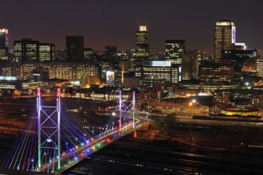
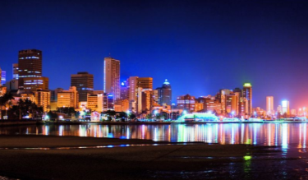




South African main metros are as trendy and cosmopolitan as any other metropolitan city in the world
Johannesburg was the most visited city in Africa in 2016, the diverse and economic hub of South Africa.
Johannesburg
Durban
Cape Town
Los Angeles
San Diego
New York

Slide 16
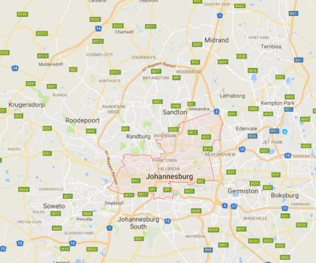
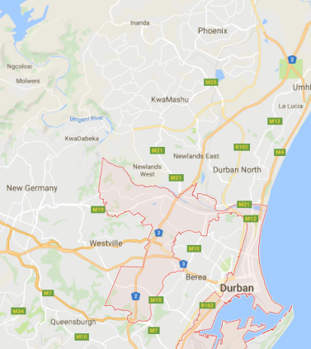
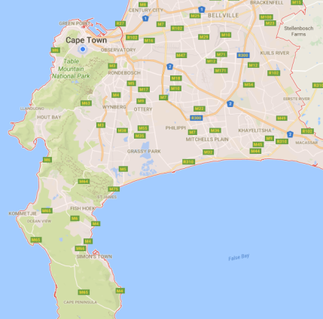
Urban townships are typically located outside of the main city hub and upper class urban suburbs
With most jobs in the city, township dwellers need to travel far, some needing to take several taxis or buses to get to work.
Johannesburg
Durban
Cape Town
Township areas highlighted in pink circles
Notes:
Hangover from group areas act – areas are segmented into socio economic living standards
Often outside / barriers of middle/ upper class living / suburbs
Implication is long commutes and non-integrated ways of living i.e. racially still segregated life style / home life

Slide 17
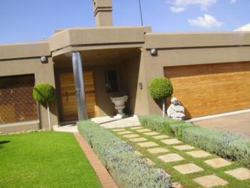
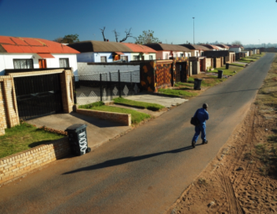
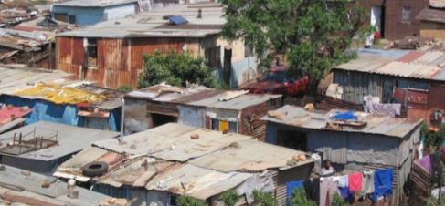
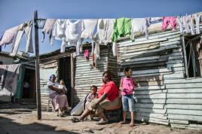
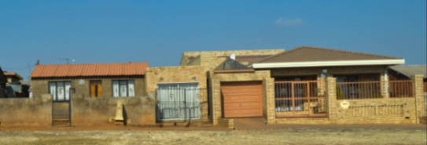
Not all South African townships are shacks, a mix of LSM 4-10 live in urban townships
As an example, these are a diverse range of homes in Soweto from different suburbs
⬇ A stereotypical image you might have seen?
➔ How about these actual Sowetan
homes/
suburbs?

Slide 18
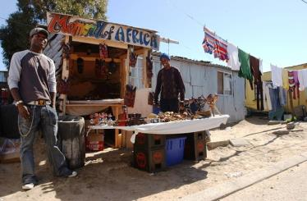
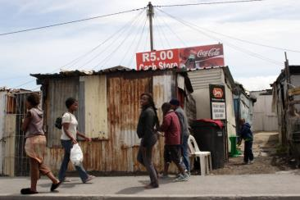
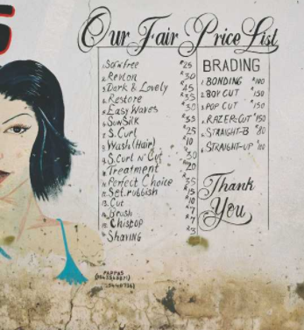
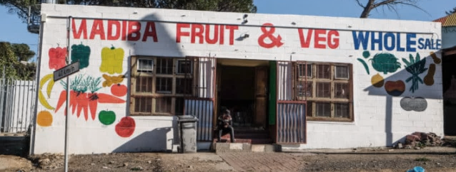
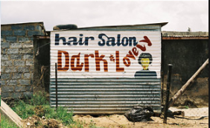
Township living is vibrant, with it’s own micro-retail ecosystem
Township shops sell the same goods as any city shop, but at a fraction of the price and without the additional transport cost.

Slide 19
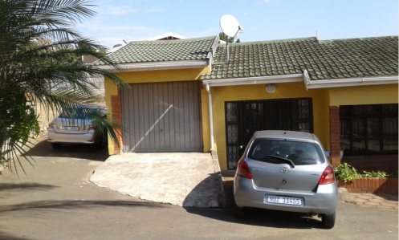
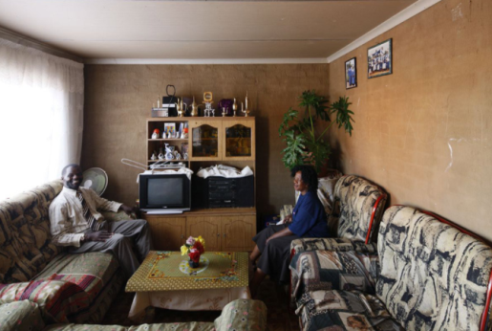
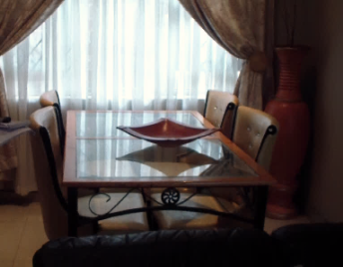
Don’t judge a book by its cover
A ‘basic’ township home on the outside could have a Mercedes Benz parked outside, a 24 inch TV, sound systems and a washing machine; just like the inside of a Sandton home.

Slide 20
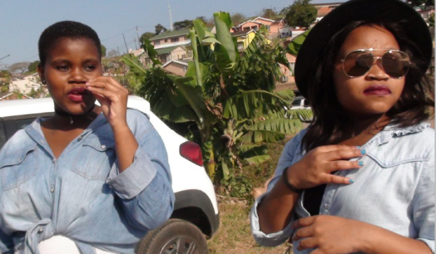
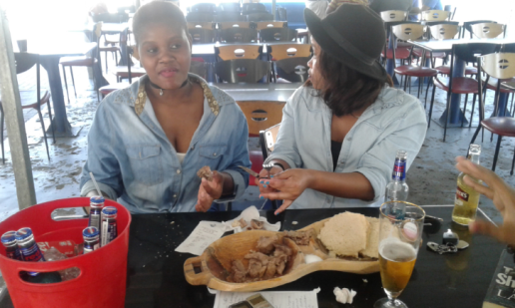
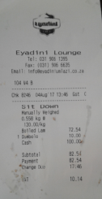
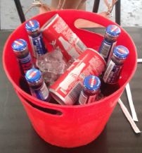
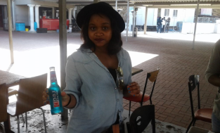
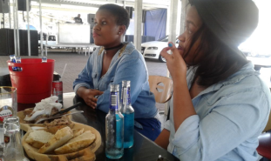
What does a day out with her friends to a Chisenyama look like?
URBAN: Meat, drinks, DJ, trendy outfit, and lots of conversation

Slide 21
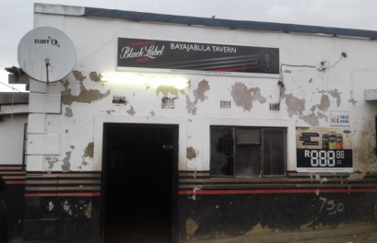
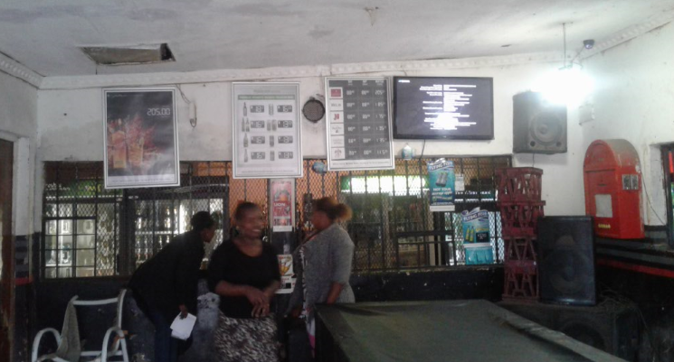
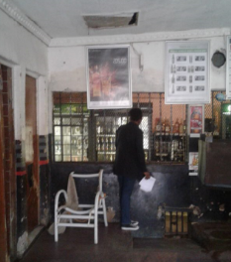
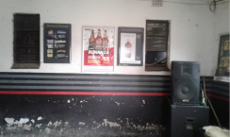
A day out to a local shebeen (i.e. tavern/ pub)
PERI-URBAN: Drinks, music and conversation

Slide 22
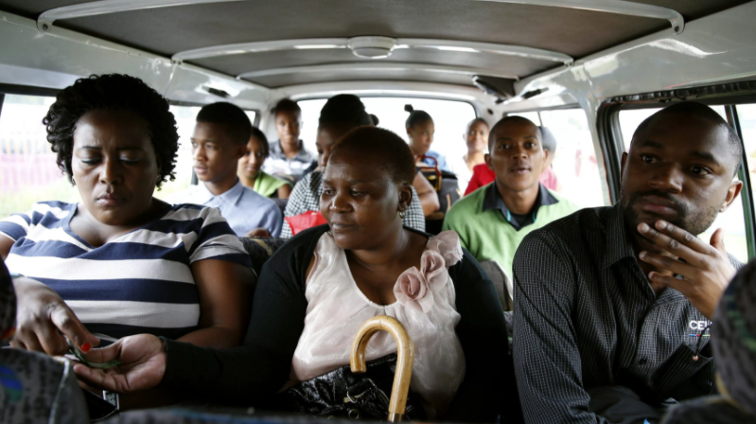
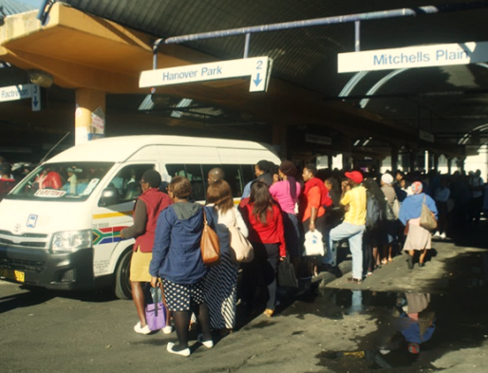
Taxi’s are the typical mode of transport for South Africans
As the cheapest form of transport and with few formal rules, taxis pick up and drop off anywhere en route from the city to township areas. They can be crowded and sometimes dangerous if the vehicle is not in good condition. Commuters buy an extra seat when they have done the monthly shopping.

Slide 23
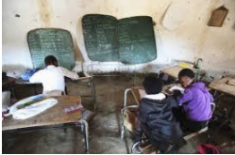
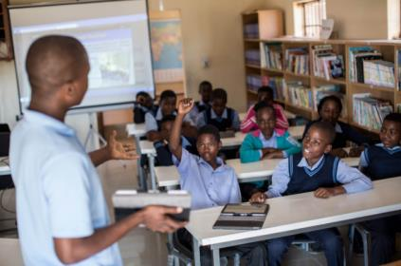
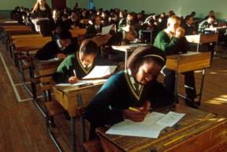
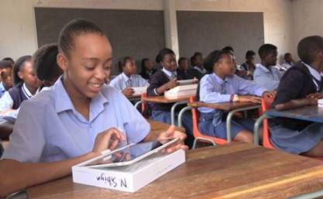
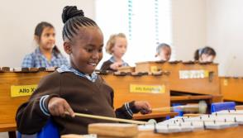
Not all South African schools are bleak. South African Public Model C Schools are tech savvy and offer after school activities and clubs.
Typically media portrayal of South African schools are rural, that’s not the reality for the peri-urban and urban girls we spoke to
⬆ A stereotypical image you might have seen?
➔ How about some urban school environments?
Notes:
Single most powerful pivot vs. vulnerability
Literal shelter from township life
Can be double edged sword – Model C Coconuts
Model C may refer to: A defunct semi-private structure used in the governance of whites-only government schools in South Africa, introduced in 1991 by the apartheid government. The term "model C" is still commonly used to describe former whites-only government schools.
(https://www.google.co.za/search?safe=active&dcr=0&source=hp&ei=FvA4WoWaK-PZgAbC2a-YCA&q=Model+C+school&oq=Model+C+school&gs_l=psy-ab.3...6049.9969.0.10197.20.12.0.0.0.0.0.0..0.0....0...1c.1.64.psy-ab..20.0.0.0...0.IYPv7bSd1NI)

Slide 24
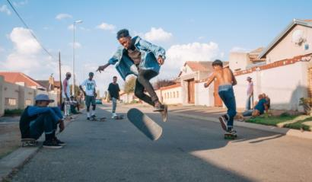
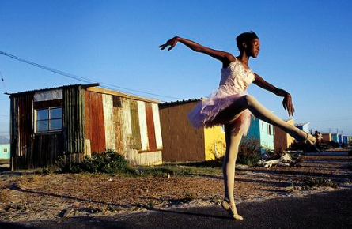
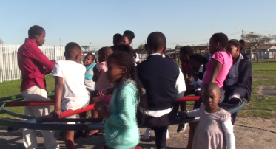
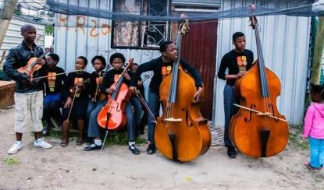
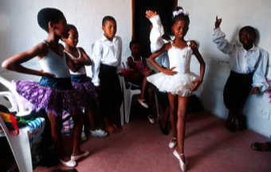
Many initiatives are started by locals in township communities to keep children off the streets, some are becoming trendy, like orchestras, ballet and ‘skate punks’

Slide 25
Being girl

Slide 26
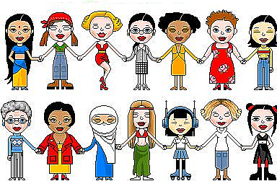
The history of segregation has left women marginalised, Born-Free’s are not much different from global Millennials
Africa
Notes:
Young South African women are like women from anywhere in the world.

Slide 27
South African ‘Born-free’ generation is very much like the global Millennial- Generation Z’s, striving for creative freedom and independence
 | MILLENNIALS |  | BORN-FREES
 | Gen Y | Gen Z
 | 1980 -1995 | 1995 - present | 1994 - present
Influences | Experiential Peers | Creational Forums
Learning Style | Visual Multimodal Café | Active Engaging Lounge
Training | Collaborative Stories | Interactive ‘Why’ driven
Marketing | Accessibility Social Media | Brand Connection Conversational
Communication | Text Traditional Media | Social Networks/ Social Media Engagement/ Activations
‘Born-free’ is South Africa’s post-apartheid generation.
Though they still battle social and economic disparity, they are dreaming big for their future.
Social media is their way of self-expression, letting their peers (and the world) know that they are thriving and ‘living the life’.
They are a generation driven towards innovation, creativity, self-expression, authenticity and making a difference.
RECOMMENDED ARTICLE: http://theconversation.com/why-bikos-black-consciousness-philosophy-resonates-with-youth-today-46909
Notes:
Like other segregated countries around the world, the generation following human injustice is more determined than ever to move beyond the wrongs and start building a new social code. Our participants were no different.

Slide 28
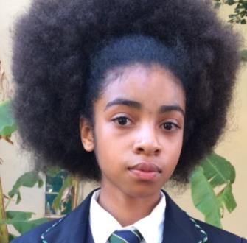
Female Born-Free’s are taking a stand in the black consciousness movement, taking a stand for ethnic rights and beauty
In September 2016, young black school girls protested over alleged racist hair policies, told that their hair needs to be ‘tamed’ (straightened, relaxed).
This ignited a movement across the country for more inclusive hair policies at schools.
The struggle continues, with new allegations this year for hair discrimination at a Gauteng school in July.
https://www.youtube.com/watch?v=uqJK4OnaPoU
The 15 year old Pretoria High School girl who spoke out first.
Notes:
Just as we’ve seen a black consciousness movement in America, our South African Born-Free’s have also ignited a black consciousness movement for inclusivity.

Slide 29

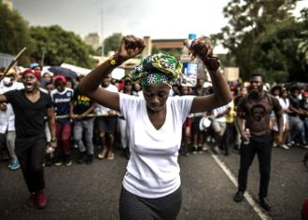
Young women are taking a stand in leading the next generation, they not sitting pretty or quiet anymore
South African black young women are not much different from the rising female protesters in America. Black women are taking back their power, showing their strength and leading their Millennial Generation forward
Baton Rouge, Louisiana
South Africa: #FeesMustFall
“People who couldn’t finish school need to go back to school. This University thing about fees must fall, I’d do it for the people that are unprivileged people who don’t have all these things. Make everybody feel that they belong in South Africa and not to feel unwelcome. Do you see why teenagers wants to go to other countries, want to experience something different now because Zuma and them are expropriating our money and what not?! So that is what I’d do for our people to feel comfortable in South Africa.”
Johannesburg, Urban, LSM 6-7, 16-17yrs
⬆ ➔
These are two iconic images of young black women leading their generation.
Wits University (Johannesburg) SRC president-elect Nompendulo Mkatsha took a peaceful but impactful leadership role during the #FeesMustFall protests over proposed tuition fee increases two years ago.
https://www.youtube.com/watch?v=x2kwp2-4I4g

Slide 30
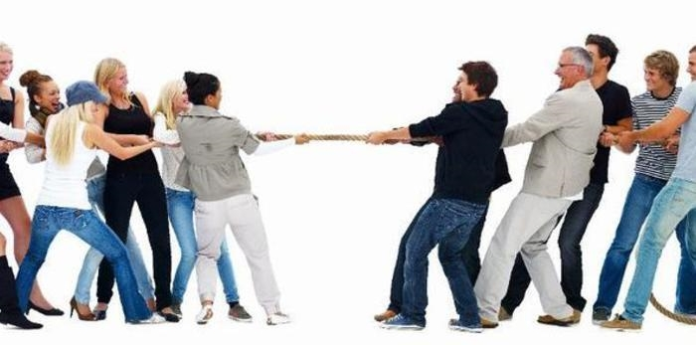
The constant struggle between cultural patriarchy and feminist mobility is what makes South African women’s narrative unique
Notes:
Despite the attitude of SA millennials, there is still a tension

Slide 31
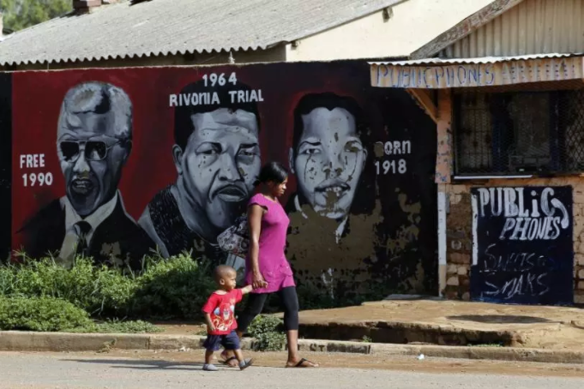
Young women in South Africa are haunted by the economic and political struggles of the nation
The economic stability of the country dictates her opportunities for education, finding employment, and access to health care.
Like so many women from countries with a history of segregation, women are typically more isolated than men. Apartheid left women from township communities disenfranchised, marginalised and isolated.
While men were away seeking work, a woman’s role was to stay home and take care of the family.
Even after 23 years of democracy, this is still the burden of most women in South Africa.

Slide 32

Post the 94 honeymoon period – a diluted sense of purpose
After decades of youth mobilisation in non-white communities specifically, the new millennium reveals a lack of common purpose, a South African truth and ideal

Slide 33


Young women are in a constant tug of war between patriarchal expectations and her need for modern independence, how she negates this dynamic shapes her role in society
Traditional Social Patriarchy Roles
Modern Identity & Self-Expression
Conforming to social expectations
Being the ‘dutiful daughter’
Virginity is social capital, sex is taboo
Gaining sexual confidence, breaking the taboo of sex
Self-expression through modern fashion
Notes:
Roles prescribed to young women are limiting, strangling her ability to transcend social limitations

Slide 34

Social patriarchy dictates gender roles and her dutiful role as a woman
In most households, young women are expected at an early age to take on the role as the carer, she has little say over in the matter. This leaves young women juggling multiple responsibilities in the household as well as trying to focus on her education
“Traditionally a woman's job is inside the house and a man's job is outside the house and in other houses you still find that a girl has to come back home has wash dishes, clean the house and cook and do everything and a boy has to just pick up papers in the yard and sometimes there are no papers so he will just go has play and a girl is not allowed to go and play.”
Durban Peri-Urban, LSM 4-5, 16-17yrs

Slide 35

Social patriarchy dynamics means that young women are needing to compete with other women to hold onto her man, this social role is one of objectified submission
The only leverage she has is to ‘keep him happy, satisfied and interested’, and she will do everything in her power to stop her partner from leaving her.
So she goes to long measures to prepare and preen her body before sex, and submits to his contraception preferences.

Slide 36
Men’s gender right to be unfaithful has been normalised, leaving young women feeling unstable and subjugated in any relationship she has with a man
BABY DADDIES
MARRIAGE
ABSENT FATHERS
TEEN BOYFRIENDS
Boys are taught by society to always be in control of a woman
Keeps the lunch money
Tells her how to act and behave
Typically sets the pace of the sexual intimacy in the relationship
Often young women fall pregnant and are abandoned by their ‘baby daddy’. She needs to manage several resulting emotions:
Personal emotions of being cheated on/ left
Needing to raise the child on her own
She further burdens her family financially
It’s normalised for men to have multiple ‘baby mama’s’, so his baby mamas compete for his attention, time and money to support her child.
Young women still emulate a ‘dream’ about marriage: own house, big ring on finger, own car. She has been told while grow up that if she is married then can be more secure, and respected in society.
There is social pressure for her to marry and leave her parent’s home, if not it’s shameful for her to still live at home.
She is more willing to put up with husband straying from marriage to keep that dream alive and remain respected and financially secure.
It is most likely that she has an absent father, which is the result of this normalised right for men to be unfaithful.
And so women run the household and take on all financial responsibilities.
If she has a baby daddy, she tries her best for her child not to also have an absent father, further spurring on her desperation to hold onto her baby daddy.
Notes:
Society accepts and prides men having more freedom to have multiple sexual partners. For women, her sexual activity brings her shame in her community. Most young women want to be in a stable and loving relationship, but are often met with disappointment.

Slide 37
Young women are struggling to find her own independence through earning power or succumb finding a man to support her
Earning Power
Blesser
Most young women are focused on completing her education. She knows that her education is a ticket to improving her life, and achieving independence.
Independence to young women is in her ability to secure her own financial and earning power.
In her journey towards financial independence, often she may only date men who have a job.
She doesn’t necessarily resort to finding a Blesser though. For her this relationship is temporary in order for her to contribute to her own and her family’s basic daily expenses (groceries, airtime, transport).
A ‘Blesser’ is another colloquialism for ‘Sugar Daddy’, implying that he is blessing her with money.
Young women often seek out a Blesser when she cannot afford the ‘finer’ things in life (weave, brand clothing/ spa treatments, spending money, her own flat or car).
Sometimes Blessers fund young women’s education, which in time will afford her own earning power.
In order for young girls to attract a Blesser, she needs to “look like you in their league”, and so often young girls exploit their sexual power in order to attain a Blesser.
Notes:
Some young women are focused on achieving her own financial independence through education, others find a ‘Blesser’.

Slide 38
Young women’s complex social ecosystem
Empowering factors
ULTIMATE
NEED
Limiting factors
Search for identity and voice as a woman
INDEPENDENCE & FREEDOM
Financial dependence on men
Relationship Power dynamics
Self-Confidence
UNDERPINNING SOCIAL LIMITATIONS
Sex Guidance/ Know-how
Sex is taboo
Un-empowered female influencers
Earning power/ access to money
Unemployment/ geographical isolation
Future security
Education is a ticket to a better future/ life
Cultural Gender Stereotypes & Patriarchy
Success through employment and earning power
Sexual/ Body vulnerability
Emotional + financial support
Family is the most important pillar of strength
Peer pressure
Society/ community’s expectations
Virginity Status
Religion
Notes:
She finds herself in a constant tug of war between factors that either limit or empower her

Slide 39

There are several access points for information on sexuality and sexual health, with peer groups being the most influential
Peer groups
Advice typically from girls in their peer groups, since sex is a taboo and merely talking to elders about sex implies that they are sexually active (which brings shame)
There is peer group competitiveness (virgins vs non-virgins) which also leads to her friends either withholding information or advising to let the boyfriend make the decision about protection
….and so, these varied sources of information contribute to a moral tension around her virginity status

Slide 40
Teenage years are the foundation for a young woman’s journey into adulthood
Pre teens (14-15yrs)
Teenagers (16-18yrs)
Post teens (18-21yrs)
Adulthood (22-25yrs)
Trying to remain a ‘good girl’
ADVICE: Not relevant yet
RELATIONSHIPS: Boyfriends
TENSIONS: pleasing parents
Trying to remain a ‘good girl’/ innocent
Start trying to attract men’s attention
ADVICE: Peer group friends/ older sister/
RELATIONSHIPS: Boyfriends/ Baby daddy (start)
TENSIONS: peer pressure/ gossip / finding her identity/ school grades
Trying to impress / keep men interested/ keep her baby daddy
ADVICE: Clinic
RELATIONSHIPS: Baby daddy, boyfriends, casual flings
TENSIONS: Reaching sexual autonomy/ completing education/ financially supporting family
Learning about their own needs and preferences, sexual health is for her own benefit now
ADVICE: Clinic
RELATIONSHIPS: Blesser/ Baby daddy, boyfriends
TENSIONS: Reaching sexual autonomy/ completing education/ financially supporting family
Fearful Innocence
Sexual Trauma
Sexual Normalisation
Sexual Wisdom & Confidence
Very innocent, most still virgins but some lose their virginity from the age of 12 years old
Very little sex-ed know-how
Learning basic fem are rituals from mother/ sister
Blind leading the blind, their lack of knowledge means they don’t know about preventative sexual health care/ products
Sabotage each other by not sharing sexual experience
Not warning each other about the risks of sex
Not give advice to use condoms
Virgins don’t ask advice, want to learn from her mistakes but this often comes at a high cost (unwanted pregnancy)
Minimal knowledge about family planning, contraception
Often fall pregnant at 16 years old in the first or early sexual encounters. After fall pregnant only then go for contraception injections
Most use contraceptives, but let her partner decide about condom use, she feels like she needs to please her partner
More know how regarding contraception choices
Wise enough now through experiences to use of both contraception and condoms
Has had experiences with men and more in control of their body and choices re contraception/ condoms/ sexual health and care
Educate
Prevention
Protection
Convenience

Slide 41
Teenage years are the most formative and vulnerable time in a young woman’s life
Peer pressure to fit into the ‘non-virgin’ social group leads her to making poor sexual health decisions. This is the window period for education and prevention initiatives.
Teenage years is a life stage full of her most important ‘first times’
Using contraception
Using condoms
Entry into sexual health practices and ‘cleansing’ rituals’
PEER PRESSURE & NEED TO FIT INTO NON-VIRGIN GROUPS
First sexual encounter (consented/ non-consented)
Sexual health ‘first times’
Entering into these situations with little information about contraception and condom use
Advice typically from girls in their peer groups, since sex is a taboo and merely talking to elders about sex implies that they are sexually active (brings shame)
Peer group competitiveness (virgins vs non-virgins) also leads to her friends either withholding information or advising to let the boyfriend make the decision about protection
Become part of the ‘non-virgin’ girl group, which allows for freer information sharing about sexual health
First sexual encounter pregnancies
= ‘teen mothers’

Slide 42

Young women’s lack of sexual knowledge can shift her from ‘good girl’ to ‘dutiful mother’ role after her first sexual encounter
Stories form teen mothers who fell pregnant after their first sexual encounter
“I knew about it (contraception) because we spoke about it in school but it was something that I've never seen before. I didn't know that you had to go to the clinic and ask for it. When I had a baby I started using birth control pills. In hospital after giving birth they show you the pills. they show you injections and that's when you get knowledge of how it works. I learned my mistake listening to a boy and not using contraceptives, so one baby is enough I don't need another one.”
Durban, Urban, LSM 6-7, 22 years old

Slide 43


Access to health care and accurate sexual information is the tipping point between empowering young women
Clinics: Access & Convenience
Nurses: Accurate Information
Township and campus clinics are young women’s primary access point for sexual health treatment
Long queues and medication shortages limit young women.
Many reported skipping their monthly check-up or contraception collection due to the inconvenience they experience at clinics.
Clinic visits are also sensitive- what if their aunt is there too? The fear of being ‘found out’ also stops young women from accessing the treatments they need.
Nurses are young women’s primary source of accurate sexual health information
But often nurses misinterpret medication/ procedure/ treatment information, leaving young women none-the wise and misinformed
There is a critical gap in the health care system. It’s important to train nurses regarding new product’s: function, benefits, and where in the body the treatment works.
Notes:
Local clinics offering free medication and contraception; and nurses are critical touch-points to empower young women.

Slide 44
Vulnerability

Slide 45

Like most narratives about women, this is a collective narrative about money, power, control, sex, gender roles, exploitation and objectification of young women in South Africa.

Slide 46

Vulnerability: Men are the abusers, women the victims
Young women can do everything in her power to protect herself and her sexual health, but the actions of those around her keeps her vulnerable
Critical vulnerabilities with men: kidnapping, rape, abusive relationships and human trafficking
These were all narratives that emerged with most participants mentioning someone they know or in their family having been subjugated to some form of sexual or physical abuse by men.
“Here in Sinqobilea a guy killed his girlfriend. He beat her up and I think he stabbed her as well. Its women being physically abused, and being killed. I like wearing shorts and sometimes I am scared to wear them because you will never know if they will rape you, so it has changed.
Q: Do boys ask you out with force, does that happen?
A lot especially at the hostel. I don't even pay attention but when they force me then I end up fighting with them.”
Johannesburg, Urban, LSM 6-7, 22-25yrs
“ There is something common that goes on here, there are a lot of gangsters who know how to entice these young children, they either get into gangsterism or the girls get used and they get introduced to drugs to get them addicted to drugs. I have heard stories of young girls being held at houses for a whole week to pay back the merchant, they have to do sexual favors for that week. Young girls, from say 14 years old.
Most times the community just turns a blind eye, they fear these merchants.”
Cape Town, Urban, LSM 6-7, 16-17yrs

Slide 47

Breaking news that has opened the lid on sex crimes against women
This is only one of many recent reports of young vulnerable girls as victims of sexual crimes, often resulting in murder.
Multiple mentions of kidnappings across the country, and is currently gaining media exposure as more girls speak out about their experiences.
In the News
Participants
“One girl at my church she had an argument with her dad and then she went outside and she has been missing since the 29th of June till now. It’s very sad because we don’t know if she is still alive or she died or is she in Ghana. People will take children and then traffic them to another country. They make them sex slaves. They say the most catch point is that they get the girls that walk in the road with earphones, because they won’t hear the car coming. I feel bad because I don’t know who they are stalking or who they want to go for next.
That was like my mum’s first rule. Don’t talk to anyone you don’t know, don’t open the gate to anyone you don’t know, don’t make conversations, don’t make eye contact. Don’t do this, don’t do that.”
Durban, Urban, LSM 6-7, 14-15yrs
This is Nonhlanhla, a 17 year old girl from Durban who was missing for two days. Her body was found in the bush in the area.
“As girls we are not safe in our own homes and on our own streets when walking to school and home from school. We are not even safe being sent for errands at home. What happened to her (Nonhlanhla) could happen to any of us,” said one of the pupils.
- Daily News, 6 September 2017, online at www.iol.co.za

Slide 48






Each geographical area has a particular set of social codes, rules of engagement and vulnerabilities within which young women are navigating
Gauteng
Johannesburg 7 million
KwaZulu-Natal
Soweto 1.3 million
Durban 3 million
Established and stable community nexus means that she has a wider social circle
Fast paced metropolitan lifestyle, so she is more exposed to social expectations with more to prove and thus more to loose
13 million
Very traditional and conservative mind-set, irrespective of urban or peri-urban location
Strong Zulu cultural roots and she is most likely to take part in different life stage rituals for initiation into womanhood
11 million
Western Cape
Cape Town 4 million
6 million
Exceptionally ‘violent’ environment due to rife Gangsterism that is synonymous with Cape Town township life
Densely populated Cape Town leads to highly competitive environments for her education and work opportunities
StatsSA 2015

Slide 49
Family life is a site of vulnerability and risk, where abuse is commonplace
Absence of nuclear households at the lowest income levels
Homes with no/little income
Small, one/two roomed houses
Multiple members in household – including uncles, mother’s boyfriend
Lack of private space
Some child headed households and unsupervised minors
Abuse rife within family structures – by blood relatives/mother’s partner - often goes unreported – need to avoid “family shame”/abuser sometimes the “breadwinner” –
Psychologically, there is a dependence on “financial providers”
Young girls at the identity forming stage are faced with early sexual induction and a lack of agency in negotiating safe sex
And so, in this space, sex, often non consensual, becomes associated with a lack of pleasure, and is largely a negative experience
“These kids can have openly talk about sex at the age of 13. They don’t talk about sex and the enjoyment of it like me and you because you don’t understand or enjoy sex at an early age”
(Social worker, Private practice, JHB)
Notes:
From a social worker pov

Slide 50
“Some of them, you know, some of the older women had people who influenced their life, these ones don’t, also the grandmothers had a way of telling, even boys about life. These ones have got grandmothers who are working, they don’t have time, even the mothers don’t have time. That is the challenge that we notice, these girls – to them there is no one to plant even common sense in them.”’
(Social Worker, Durban Hospice for Women, DBN)
And within the space of the family, there is a significant lack of female to female conversation about sex and sexual health
“….she fell pregnant and then you try to speak to the mother, the mother said no she is now a woman, she has a child, she must mind her affairs of her family, her as a mother was minding the business of her family.”
(Social Worker, Dept of Education, DBN)

Slide 51
Intimate relationships are driven by dependence and control, and there are compromises made with regard to maintaining sexual health
Growing trend of dating older men – girls make compromises regarding sexual health in order to gain financially
Needs/requirements of boyfriend are often put first – some compromise on contraception use
Non-monogamous relationships – with both “blesser” and boyfriend – leads to high incidence of HIV/AIDS
Relationships of abuse – crimes not reported due to dependence on partners

Slide 52
While there are several interventions to inform young women on sexual health, overall, there is a perceived lack of information about contraceptive options
Life orientation classes provided in high school
3
Interventions/awareness campaigns from Departments of Economic Development, Justice and Home Affairs
1
4
2
loveLife* campaign – peer sexual education programmes
Department of Health – representatives educate school children on contraceptive/condom use
BUT…
Despite these, there is widespread non-awareness of contraceptive options other than condoms
And for the poorest communities, little familiarisation with resources and services in the community (radio, word of mouth, newspapers)
These interventions are not deemed to target the problem at the source – from the space of the family, are not sustained, and are not driven by influential role models and spokespeople
*loveLife is a youth focused HIV prevention initiative in South Africa. The not-for-profit organisation promotes AIDS-free living among South African youth aged between 12 and 19 by employing a holistic approach to youth development and behaviour change that motivates adolescents to take charge of their lives for brighter futures.

Slide 53
And there is a deeper psychological battle
Abuse and neglect have a role to play in how young women’s behaviours and how they assimilate information about sex and sexual health
“It is very hard to deal with someone who has been abused particularly those who have been raped. I sometimes struggle to believe that they have indeed been raped, I don’t know. Psychologically I also struggle to deal with that because it is easy for rape victims to befriend men. If a man would do this to me, I would be scared for instance to roam around the streets at night because of the danger that comes with it. But with them, I don’t know….”
(Social Worker, Dept. of Social Development, Inanda, KZN).
Low self esteem
Doubt
Dependence
Lack of self love
“It is affecting them in a huge way because with some of them they start believing that this is what they deserve it has become normal, they get to the point where they don't report these case, they accept whatever is going on or happening to them, so mentally hey believe that this is how my life should be or I deserve this. First the uncle and then it's being kidnapped on the streets and then it's the boyfriend, so it's like this is normal to me, this is how my life should be which is wrong ….”
(Social Worker, Orange Farm Clinic, JHB).
Non-assertiveness
Less inhibition

Slide 54
“…they are able to see that there are older women who are making it, they are not married and not dependent on a man. They are able to live comfortably and make their own choices”
(Social Worker, Durban Hospice for Women, DBN)

Slide 55
Womanhood and Sexual Autonomy

Slide 56

Looking at emerging typologies to understand SA young women

Slide 57
Five differentiated young women typologies emerged
PRIVILEGED
The Good
Girl
Material
Girl
Thriving
Protection
Savvy
Exploring
LOW RISK
HIGH RISK
Striving
Surviving
Responsible Mother
Gender
Prisoner
SURVIVAL

Slide 58
Typology dynamics
PRIVILEGE VS SURVIVAL
PRIVILEGED
Generation reaping the success of parent’s upward mobility.
Second generation completing High School/ Tertiary education
Nearing economic freedom
Higher disposable income
The Good
Girl
Material
Girl
Thriving
Protection
Savvy
Finding
LOW RISK
HIGH RISK
Striving
Surviving
Sexualised through media and celebrity body culture leading to sexual confidence
Responsible Mother
Gender
Prisoner
Feminist orientated, breaking free from cultural and social patriarchy
SURVIVAL
Sexually active and has multiple partners
Use and need a wider range of fem care and sexual health products
LOW VS HIGH RISK
Notes:
What makes them different – economic power goes down to survival – as they go up the axis, they have more opportunity and more disposable power – lean on parents upward mobility i.e. parents had high school or tertiary education. They have more money to spend. The more privileged, the more exposure to social media. Peri-urban not in this axis. The good girls are on this axis. The upward mobility allows them to break through gender patriarchy and express themselves

Slide 59

Responsible
Mother

Slide 60


Responsible Mother
Sheltered upbringing has kept her focused
Psychographic Profile
Home Life
She has a strong need to be a responsible mother to her child., and so she is focused on completing her education and finding a stable job.
She is a home body, preferring to spend time at home with her family or quality time with close friends. Being trendy or fashionable is not important to her, so she doesn’t party or have multiple sexual partners- that’s too risky for her.
Her family have kept her sheltered by being very strict when she was younger, and enjoys the comfort of a structured lifestyle and avoids any risky or vulnerable situations.
She contributes to household financially and has many responsibilities, which keeps her focused on establishing a better life for herself and her child.
Critical Life Events
Relationship Status
Fell pregnant after her first sexual encounter, which has drastically changed her life and view about sex.
She has since isolated herself from the ‘bad girl’ peer groups, prefers to stay home and focus on her studies and providing for her family and child.
Either single/ not dating or in a stable committed relationship
Cautious in relationships, needs to trust her partner and have an equal say in using protection
Her focus on improving her life outweighs her need to fit into ‘trendy’ sexual peer pressure.

Slide 61


Responsible Mother
Her isolation and over-focus on pregnancy prevention makes her vulnerable to STIs
Vulnerabilities
Over-focus on pregnancy prevention leads to a STI ‘blind-spot’.
Lack of accessible and accurate information.
Her social isolation means that she relies on sexual experiences and experiential implications as her guidance.
Multi-purpose her pregnancy products to prevent STIs
>
Relevant Initiatives
Communication & Messaging
Education through practical and accurate sex-education and STI prevention
Key Gate Keeper Partnerships: Educational institutes; work environments; Clinics
Messaging:
Product reliability and effectiveness
Critical product benefits and explanation
Not up to date with Social Media trends
Observer rather than a participator

Slide 62

The Good Girl

Slide 63


The Good Girl
Protective environment allows her to thrive
Psychographic Profile
Home Life
She has a strong need to please family and society’s expectations of what it means to be a woman, and so is willing to ‘sacrifice’ social acceptance in order to abstain from sex and remain a virgin.
She is a top academic achiever who has remained focused and disciplined at school and in her extramural activities.
Her family has kept her sheltered by being very strict, which minimises vulnerable situations and risk.
Typically her mother was a teenage mother, thus is protective and present in her life.
Has been taught that hard work pays off, nothing in life comes easily but she has the power to change her own life.
Critical Life Events
Relationship Status
She knows that her education is her ticket to earning more freedom from her family's expectations, as well as giving her the power to break free from cultural gender stereotypes. She wants to succeed more than anything, and she is in a environment that allows her to thrive.
She would love to date, it is forbidden by her family.
Social and family pressure out weighs peer pressure.
Not exposed to an overtly patriarchal family structure- brothers and sisters all share chores (washing, cooking and cleaning)
Balances both cultural women ceremonies and Christian religion.

Slide 64


The Good Girl
Her inexperience and lack of knowledge makes vulnerable in her first sexual encounter
Vulnerabilities
Critical vulnerability is in their inexperience with sex or the need to protect/ prevent STIs/ pregnancies.
Fem care and prevention myths. Their ‘shyness’ in talking about sex means that they have limited access to information or sex-education.
First sexual experience infection/ pregnancy.
Equip and prepare her with accurate information
>
Relevant Initiatives
Communication & Messaging
Education through practical and accurate sex-education
Amaqhikiza groups [Older girls advise younger girls]
Key Gate Keeper Partnerships: Church, Model C Schools, Mothers/ Parents
Messaging:
Social and community status of her: purity, abstinence, virginity
Her ‘sacrifice’ of abstaining is worth it in the long run
Observer rather than a participator

Slide 65

Protection
Savvy

Slide 66


Protection Savvy
Know-how is her safety blanket
Psychographic Profile
Home Life
She has a fierce sense of independence and self-confidence, striving to explore her options to a bigger and brighter future. She plans to achieve success with a well balanced sense of working hard and having fun.
She has managed to break free from conforming to patriarchal expectations, and is not afraid to stand up for her rights as a woman.
Typically from a stable and well educated home. Line of communication between her and her strong female role models means that she has both emotional and financial support.
She is responsible in her duties to her family, helping out around the house and with household expenses.
Critical Life Events
Relationship Status
She has learnt through other women’s experiences, and seeks out sexual health information. So she has managed to avoid any threats and risk to her health.
Steady dater, with some flings in-between long-term boyfriends
Trust is important to her, so she selects her partners based on their ability to let her have a voice in their sexual relationship.

Slide 67
Protection Savvy
She is typically prepared, but she is vulnerable in unexpected moments/ incidents
Vulnerabilities
Occasional flings or one night stands increase her risk of contracting a STI.
Not having back-up protection for unexpected moments.
Misunderstanding information in her online searches.
Ensure she is prepared for the unexpected
=
Relevant Initiatives
Communication & Messaging
Participation sexual health activations
Key gate keepers: clinics, education institutions, Sexual Health NGO’s/ Organisations/ Initiatives
Positioning Messages:
Prepare for unexpected vulnerable moments (rape/ self-defence)
Have back-up protection on-hand
Responsible but fun sexual encounters
Participates and observes when on social media. She is not afraid to add her two cents to a relevant thread

Slide 68

Material
Girl

Slide 69


Material Girl
Confident material girl is her sexual currency
Psychographic Profile
Home Life
She is confident in her sexuality and uses being a woman to her advantage. She is always on the forefront of the latest fashion trend, and will be out and about showing off her latest outfit or expensive accessory.
She loves to party, socialise and have a good time; as long as she is in the right crowd who will give her the appreciation she feels she deserves.
Her household life is not always stable, things may not be what they seem. She is often out and about socialising, and so spends little time at home.
To her parents she is a good girl, but they don’t know what she gets up to. Her parents are not too strict, so she takes liberties as often as possible.
Critical Life Events
Relationship Status
When she found her confidence and power as a woman during one of her sexual encounters. This has opened up a world of finding social acceptance through
She has multiple sexual partners, some are flings or short term relationships.
Of all the typologies she is most likely to have a sugar daddy or ‘Blesser’ who expects sex from her in exchange for financial security (education) or gifts.
Though she is confident, she allows her partners to dictate their protection preferences. As a precaution, she will always be on ‘the pill’ to prevent unwanted pregnancies.

Slide 70
Material Girl
Multiple and impulsive sexual encounters makes her vulnerable in-the-moment
Vulnerabilities
Multiple casual partners and impulsive decisions increase her risk of contracting a STI.
Partners preferring not to use condoms. She needs a back up option that does not impede his pleasure.
Forgetting to take the pill/ go to clinic for her injection.
Empower her with a covert STI prevention product
>
Relevant Initiatives
Communication & Messaging
Participation sexual health activations
Key gate keepers: clinics, education institutions, Sexual Health NGO’s/ Organisations/ Initiatives
Clubs/ tavern dispensers
Positioning Messages:
Protect yourself
Have back-up protection on-hand
Responsible but fun sexual encounters
Product Packaging:
Trendy, modern, feminine
Content creator and vocal participator

Slide 71

Gender
Prisoner

Slide 72


Gender Prisoner
Economic instability leaves her powerless
Psychographic Profile
Home Life
She conforms to cultural and social gender roles, and has little power over her life situation. Her family does not have the financial capability for her to attend a good school, and so she feels trapped in her situation.
She seeks social acceptance through sexual encounters which earns her a place in her peer group.
Typically lives in an unstable home with limited financial security. She has many financial responsibilities and takes on the role as surrogate mother to her siblings/ cousins. Her parents are not strict and often not at home to keep an eye on her, so she has free reign to do as she wishes.
Critical Life Events
Relationship Status
Her economic instability has thrust her into a difficult and powerless situation. With more than one child, she is overwhelmed by responsibility which she tries to escape by partying over the weekend. Since she fell pregnant she dropped out of school, and has few opportunities to improve her life.
Multiple sexual partners, typically has more than one child and fell pregnant when she was a teenager.
Often her sexual relationships are abusive, and she has very little say in protection or prevention.
It is expected of her to ensure that her partner is satisfied according to his preferences.

Slide 73
Gender Prisoner
Her lack of know-how and power makes her the most vulnerable
Vulnerabilities
Lack of sexual health protection/ prevention knowledge means she has learnt through experience and she is unprepared for the unexpected encounter.
Sexual healthcare and clinics are inaccessible or struggles to find time to make routine visits.
Multiple partners and unprotected sex.
Empower her with easily accessible ‘covert’ protection/ prevention products
>
Relevant Initiatives
Communication & Messaging
Mobile clinics/ education activations
Key Gate keepers: church, township schools, township/ peri-urban/ rural clinics
Shebeen/ tavern dispensers
Messaging:
Protection without ‘him’ knowing
Packaging:
Not overtly a sexual health product- help her protect herself without her partner knowing
Observer rather than a participator

Slide 74

A young girl’s path to womanhood is not a clearly defined journey. Again she faces acceptance or rejection; based on her virginity and ability to conform to being a ‘good girl’ or ‘dutiful woman’

Slide 75
The concept of womanhood shows the tensions of traditional prescribed roles
Underlying all these themes of initiation and rituals that allow a woman passage from being a ‘good girl’ to a ‘dutiful woman’ is the sisterhood.
This sisterhood is both nurturing and competitive, depending on the women she interacts with in each of the definitions, expectations and initiations of womanhood.
The psychological characteristics that women are taught (nature an nurture) in order to overcome struggles and challenges.
Strength is her shield, and resilience is her experience of practicing strength
ROLE: “Pillar of Strength”
Sisterhood &
Support
Systems
Strength &
Resilience
Themes that define womanhood
Cultural right of passage is the traditional initiation into womanhood, where age old Zulu ceremonies determine whether a girl has the right to be seen as a woman in her community.
ROLE: “Dutiful Woman”/ “Dutiful Wife”/ “Dutiful Mother”
Cultural Right
of Passage
Virginity
Virginity is a young woman’s social capital that allows social acceptance in her larger community structures.
Remaining a virgin is critical for her to be accepted by the ‘institutions’ of her community: church, elders, ancestors etc.
ROLE: “Good Girl”
Sex vs.
Promiscuity
Sex is a young woman’s peer group equity that allows her acceptance into her peer group circles.
Being initiated as a woman through her sexual encounters allows her to fit in and ‘norm’ with her peers.
ROLE: “Modern Woman”

Slide 76

A young woman is expected to be ‘the pillar of strength’, a role she can never escape
Being a woman is synonymous with qualities of strength and resilience. Young women all associate psychological characteristics of strength as her way of coping with life challenges, her duty to her loved one and a proverbial role as a woman. Her ability to be resilient is defined by how many challenges she has overcome, thus the older she is the more strength she has managed to accumulate. Her role is to be “the pillar of strength’ for her family, which she is able to show through her ability to provide, nurture, care and serve her families needs.
“Firstly being strong through all the hardships one has been through in life and not letting them have a negative effect on you.”
Cape Town, Urban, LSM 6-7, 16-17yrs
“They always say men are strong, but according to me women are stronger.”
Durban, Urban, LSM 6-7, 14-15yrs

Slide 77

Sex is taboo, so young women feel like they need to hide their sexual status. Those in the ‘Modern Woman’ role lead ‘double lives’ between their friends and family.

Slide 78

If she is living a modern sexually active life, society shuns her
Strong social stigmas that sexually active young women show physical signs of her ‘impurity’ leads to a disconnect between traditional social expectations and her finding her power as a woman.
“They say that whenever you sleep with a man, your body tires out. Our neighbors whenever you walk by, they say just look at her, her body is falling apart. They say your body starts showing that you’re no longer a virgin. I don’t know how they see it, I’ve never seen it.”
Durban Peri-Urban, LSM 4-6, 16-17yrs

Slide 79

In KwaZulu-Natal, couples practice ukusoma in order to navigate around the traditional rules of a young woman keeping her virginity. She can fulfil both roles as: “Good Girl” and “Modern Woman”
Ukusoma is the Zulu term for monoamorous simulated intercourse (i.e. outercourse). Colloquially known as ‘thigh sex’.
It is a common practise amongst the Zulu for preparation for future adulthood sexual practises.
It is practiced in rural KwaZulu-Natal in order for young women to remain a virgin while she is in a relationship.
But, she can still fall pregnant and is still at risk of contracting STIs. There we accounts of known girls who are pregnant virgins.

Slide 80

A young woman’s sisterhood is the protective shield of support she surrounds herself with to guide her through her path to womanhood
Notes:
Young women seek support with the women closest to them, those they trust
Young women are able to be more open and honest with their sister than their mother. There is too much at risk for her to share her mother all her sexual stories or concerns. Young women’s mothers/ aunts play a primary role in emotional support, since these are the women they have learnt their strength and resilience from.

Slide 81


Not all sisterhood relationships are empowering, there is rife competition within her peer group, that can often leave young women worse off
Nurturing
Competing
Nurturing and supportive peer groups advise each other based on their own intimate experiences and relationships.
This is a circle of cumulative knowledge that allows women to navigate their way to womanhood.
Young women struggle with girls in their peer group that are mobilising towards success, social acceptance or earning power before them.
This leads to situations where sexual advice is withheld, warnings about a man’s negative characteristics is left out, body shaming to disempower confidence and
Young women find themselves as victims of sisterhood sabotage, hindering their path to confidence and sexual autonomy.
Notes:
No one is as hard on a black young women, than other black young women. Though this may seem polar opposites, these two sides are in constant tug of war in most relationships, coexisting in her sisterhood network.

Slide 82

Young women seek romantic solace with other women, to counteract the violence and risk they experience in relationships with men
Of the young women we spoke to, only one had a personal experience with another woman, but when it became sexual (beyond comforting romance) she withdrew.
“Its because of the violence and also your boyfriend cheats on you, you get sick and when you date another girl you will not get sick with HIV. .”
Johannesburg, Urban, Krugersdorp, LSM 6-7, 22-25 yrs
“I dated a girl but it was a phase- I went to a girl’s school and it was a thing.
She was the most popular girl in school, they called her 2Pac because she loved 2Pac. She was very beautiful and was a tomboy, so I dated 2Pac. I wouldn’t even classify myself as a lesbian and we didn’t even do much we would just kiss and hug and call each.
Then 2 years back I met this lesbian friend who always wanted us to date. She wanted to go down and I was like it’s not going to go down like that.
I’m not judging them or anything but I don’t like it because she touched me in a way that I’ve never been touched by another woman. In bed I felt someone touching me and I felt it was demonic for me. It felt wrong.”
Johannesburg, Urban, Soweto, LSM 6-7, 22-25 yrs

Slide 83

Sexual Autonomy

Slide 84

Young women’s beliefs about her role as a woman and her sexual health is a product of her social context and the people who are in it.
Her need for sexual autonomy and identity creation unites all young women in South Africa.

Slide 85

Young women use their sexuality through fashion as social capital, not only to fit into peer groups but also to stand out amongst the crowd to find a man.
Irrespective of her economic status, the Kardashians and South Africa’s ‘KimK’, Bonang, are key celebrity role models.
Young women are imitating a well crafted celebrity representation and expression of femininity under the pretence of finding her own identity and sexual autonomy as a woman.

Slide 86








Western celebrity pop culture impacts her perception of beauty and body consciousness, often she is walking a fine line between self-expression and sexualised exploitation/ objectification
Though Western pop culture argues to empower women by expressing their sexuality, young women feel like they are rebelling against traditional and cultural patriarchy and shaping their identity as women.
She feels gratified that her sexual confidence gives her strength and higher social status. The irony is that in doing so she is still not able to break the stifling chains of patriarchy, since her manner of sexual autonomy still panders in gaining the attention of men. She is transferring being objectified to becoming sexualised.
Celebs
Participants

Slide 87










Modern body consciousness may bolster sexualisation and a singular beauty image, but it is also leading a drive towards constructive physical confidence and beauty rituals
Fit, lean, healthy body
Singular beauty image
Celebs
Participants

Slide 88



Gym is slowly becoming a vital part in a young woman’s daily routine, those that cannot afford gym fees exercise in local parks or sports grounds
Participants included exercising routine as part of her self-care ritual.
Feeling physically strong boosts her sense of physical strength, which empowers her in vulnerable situations.
Exercise helps her manage her weight to feel comfortable, combat body shaming, and be more desirable to men. This boosts her confidence and helps her find a sense of power in her sexual relationships.
Local park
Sports grounds
Local gym
Virgin Active (trendy)

Slide 89

But, body shaming is a common practice amongst young women
Young women feel intense peer pressure to emulate a Western concept of body beauty- to be tall and thin. Often young girls partake in ‘body shaming’. This is heightened young women’s body image and sensitivity.
“Let's say you are walking with someone with a big body- you would say like: ‘Look she is thin and the other one doesn’t have a bum’. Just like that! Like others have this habit when they form a group with people with the same pretty body type.
It puts pressure on you that you have to gym. You get home and are like: ‘Today I won't be eating pap I’ll just drink water’, because I have this pressure that I want to look like her because she is skinny and tall and all that. You just want to look like her!”
Johannesburg, Urban, LSM 6-7, 16-17yrs

Slide 90


A young woman’s virginity is attached to morality and to her family, creating a tension
The context of “virgin vs non-virgin” pulls girls in two directions and, a moral tension is created:
VS
Ridicule from peer group for being a virgin.
The need to belong to certain groups gives her social currency
Shame from family and elders and a stigma attached to being a non-virgin

Slide 91

And so her virginity is a badge of pride and a source of social currency
A girl/young woman is defined by her virginity, and virginity is used as social capital or a badge of pride to her and for her family
There is a push from mothers to remain as virgins as this has very important cultural/moral family implications
Virginity is also within the domain of the church – church requires a coming of age ceremony. The Shembe church separates women's seating based on their virginity status, leaving teen mothers lost between being a ‘girl’ and being a ‘woman’
Social stigma and shame of teen mothers: If a woman falls pregnant before marriage then she needs to pay damages: she pays money to cleanse the maidens, cleanse the Temple, cleanse the leader and she must also cleanse herself before she goes back to church and join the Older women group. [See slide overleaf regarding implications of cleansing]
She may not take part in either of the traditional older maiden ceremonies.
Teen Mother displacement: “The fact that I have a child doesn’t make me a mother (Umama). I am still a girl.” Durban, 18-21yrs
Shembe: African Initiated Nazareth Baptist Church, Sabbath observers, approx. 4.5 million followers, premarital sex is forbidden. Three factions in KwaZulu-Natal, one faction in Gauteng.

Slide 92

Virginity and the symbolic discourse of purity
For young girls, traversing the hierarchy from young maiden to mother is a journey to becoming impure.
The loss of a young woman’s virtue with the loss of her virginity, gives rise to the practice of ‘cleansing’ , which in itself, has both a symbolic and tangible element

Slide 93
Cultural and religious symbolism of ‘cleansing’ has manifested in sexual health rituals as a pre-occupation with needing to be clean/ cleansed before and after sex
Yet another tension is created in trying to bring a symbolically unclean object into control – to get them back to that unsullied versions of themselves that they used to be
Social taboo of lost virginity
Feminine Hygiene
Vaginal cleaning is taught by mother from the time of first menstruation, and becomes a critical part of her daily hygiene routine; even more so after her first sexual encounter
Loosing virginity/ becoming pregnant changes how community views her- she is still a girl but has spoilt herself, and has become ‘unclean’ or ‘dirty’ in the eyes of her community. This is shameful and embarrassing for her.
Need for constant vaginal cleaning, with many myths on how to clean having emerged over time.
Symbolic discourse of ‘cleanliness’ and ‘dirty’ is subconsciously manifested as needing to keep vagina clean.
Smell (even natural smell) and any natural discharge is feared as a physical sign of their ‘uncleanliness’ in society.

Slide 94
Category Attitudes & Behaviour
Notes:
Navigate category
Brands
Retail
White spaces

Slide 95
Product category fit with young women’s underlying needs
Mapping the polarities that drive the tensions between finding her sexual autonomy/ freedom and conforming to social codes.
Suppressed sexual freedom, with a need to please her partner/ social expectations.
NEEDS MET:
Very few of her own needs are met, she feels gratified in serving as ‘Good’ or ‘Dutiful’
NEEDS UNMET:
Sexual health privacy and sensitivity
Her own sexual gratification without risking her place in society
Sexual Stimulants
Geared towards her image and sexual freedom, but still needs to keep her partner interested.
NEEDS MET:
She can look and be what she wants to be
Variety of personal care products
NEEDS UNMET:
Freedom without putting herself at risk
Multi-purpose contraceptive
Spermicide
Her own sexual stimulation
Little access to products
Beauty, Hair & Body Care
Care-free
Risky
Menstrual Care
Traditional
Modern
Intimate Cleaning
Conforming
Careful
Contraception

Slide 96
The most important underlying need to be gratified, the pre-cursor to product development
These need gratifications can form the basis of product innovation, marketing strategy and resonant messaging.
MAKE SEX EMPOWERING AND ENJOYABLE FOR HER
Her pre-sex rituals are not about her pleasure, it’s all about him.
Care-free
Risky
Traditional
Modern
MAKE HER SELF-CARE RITUALS ABOUT HER
Cleanliness and smelling fresh is about being presentable and agreeable to those around her.
Conforming
Careful

Slide 97

Sexual Health & FemCare Products

Slide 98
And there are some myths around the use of contraception…
1
Little knowledge of sexual health – more on preventing pregnancy – so contraceptive but no condom
2
Misbeliefs about contraceptives speak to the need for information and discourse around the use of contraception
….makes people disabled,
….causes rashes on the face
….female condom is too big/can get stuck inside
….contraceptives make me fat
“But remember if you are going to take a pill or you are going to inject yourself the only thing that you are preventing is pregnancy so it’s not health. And that’s what kids don’t understand you still need to condomise ”.
(Social worker, private practice, JHB)

Slide 99
Further, interactions with public servants are deemed to be problematic in young women’s attitude to sex and access to sexual health information
Public servants (teachers, nurses) are considered to be judgemental - leads to lack of use of clinics to request contraception for fear of being found out for having sex
Fixed clinic times are often inconvenient for young women looking to request contraception and advice i.e. contraception is offered at fixed hours
Teachers, while equipped with life orientation knowledge, are overburdened, and often permit adverse sexual behaviour within school premises
Rape centres and clinics are not friendly towards young women – accused of promiscuity; chastised for being HIV positive
“They don’t want to speak to females most of the time. I asked one of the learners why and they said – women are like mothers, when you speak to them they become too emotional”
(Social Worker, Dept. of Education, KZN).
There are several points of access to information about sex – all perpetuating idea of sexual activity as negative

Slide 100

Myth: Young women are fearful of using injection and implant contraception methods that stop her period because they are uncertain of ‘where the blood goes’
Several mentions of ears and nose bleeds, young women perceive that because the injection/ implant stops her menstruating, then her menstrual blood has no where else to escape other than her nose and ears.
When checking on these symptoms at a clinic, this is the explanation given to them by the clinic nurses.
So, there is a strongly held belief that it is dangerous to stop period all together.

Slide 101
In order to keep her partner interested, young women have pre-sex preparation rituals to show her partner that she takes care of herself and wants to please him
Young women leverage whatever power she has, and in this case she has control over her own cleanliness and appearance. Vaginal cleansing is part of her typical fem care ritual, but she needs to step this up a level to make sure that her partner enjoys having sex with her. So this ritual involves methods of vaginal tightening and heating immediately before sex.
Vaginal cleansing
Vaginal heating
Pre-sex ritual
Vaginal tightening
Fresh, clean
Smell good
No sign of infection or rash
Believed that heating also leads to increased tightening
Tightening indicates that she has not been unfaithful to her partner
Tightening reiterates and reaffirms cultural importance of virginity
Maximise his pleasure
Distinguish her from his other partners
Shows that she knows what he wants

Slide 102





Myths: Her pre-sex ritual is rife with vaginal tightening and heating myths that have been handed down to her from her sister or friends. She uses household products to achieve her sexual stimulation goals
Vaginal Cleaning
Vaginal Heating
Vaginal Tightening
SUNLIGHT BAR SOAP
Perceived as the most pure soap, no fragrance, has a good soaping sud,
Literal interpretation that can clean away any dirt/ semen/ diseases too
KUMBUCHA TEA
Probiotic producing plant steeped in tea
Use to help clean bladder or clean out blood clots while menstruating
This process is used for both cleansing and tightening
KNORROX STOCK CUBE
Spices in the stock cube allow her to feel the heating effect
Insert into vagina, wear panty liner to keep intact, remove after 20-30mins just before sex
TRADITIONAL ‘SNUFF’
Snuff is a rational ‘tobacco’ which can be chewed, sniffed or smoked
She rubs herself internally with snuff
Though snuff burns badly, the more it burns the more it cleanses and warms
Some girls smoke snuff as an aphrodisiac
STONEY SOFT DRINK
Ginger allows her to feel the heating effect
Stoney used because it does not burn like other experimented household products

Slide 103

Critical insights into household product myths: trust, literal explanations and tangible benefits
House hold products are easily accessible, affordable and established as trusted brands
Literal interpretation of intended product benefits applied to different sexual health uses
Tangible physiological results because it’s effect mirrors and heightens the relevant senses

Slide 104

Myth: Sexual health products act as spermicides after sex
Most pharmaceutical products are not understood, and clinic nurses are unfortunately not communicating the true product use, application and physiological processes.
So, literal interpretation and miscommunication from clinic nurses about fem care pharmaceutical products are leading to ‘cleansing’ products being used after sex as spermicides, replacing the use of condoms to prevent contracting STIs.

Slide 105


Products misused as internal cleansers and/or spermicides
Flagyl is an antibiotic used to treat bacterial infections of the vagina, stomach, skin, joints and respiratory tract.
Nurses’ communication about product ‘cleanses the bladder and uterus’
Helps strengthen the immune system and relieve menstruation, fatigue, sexual performance, and digestive problems.
Stametta is recommended by her mother and friends, bought over the counter.
REAL LIFE SCENARIO
Young women (18-25 year olds) are using Flagyl after sex as a ‘cleaning’ product. They believe that Flagyl cleans out their uterus from dirt, sperm and any bad smells that are not to her partner’s liking/ or could indicate that she is ‘unclean’. She takes one pill after sex, and does not understand that it’s a course of antibiotics.
Though these women are all using contraceptives (pill or injections), those that prefer not to use a condom believe that Flagyl will prevent them from contracting any STI if they ensue they wash well and use a product that can cleanse internally.
REAL LIFE SCENARIO
Adult women (22+ years old) are using Stametta for a range of internal cleansing purposes. They believe that Stametta cleans their bladder and uterus after sex to dispel semen (instead of using condoms) and vaginal discharge.
It’s believed that Stametta’s cleansing power can help terminate and prevent pregnancy after unprotected sex. Some also believe that it has the ability to stop her menstrual cycle, a welcomed benefit so she is ‘clean’ throughout the month.

Slide 106


Products misused as internal cleansers and/or spermicides
Intimate cleanser, gently cleanses away odour-causing germs, pH regulation.
Inherited brand/ product from mother/ sister’s intimate cleaning ritual.
Urinary alkalinise, alleviating symptoms of urinary tract infections, burning urine and frequency.
Recommended by clinic nurses to cleanse her bladder and uterus of semen and discharge after unprotected sex.
REAL LIFE SCENARIO
Young women (14-25 years old) use Gynaguard as an intimate cleanser as part of her daily bathing routine. Some believe that Gynaguard has the ability to work like a spermicide if she washes just after she has had unprotected sex.
Gynaguard is also used to eliminate any unwanted discharge or bad odours in preparation before sex. It is perceived as an expensive product, so some women alternate or replace with Sunlight soap bars.
REAL LIFE SCENARIO
Adults (22 years and older) use Citro-soda to clean their uterus and bladder after unprotected sex. They believe that Citro-soda eliminates dirt, semen and brown discharge. Yellow and pungent odour urine is an indicator for her that it’s working.

Slide 107

During her menstrual cycle, young women need products that can help her gain a greater sense of privacy
Menstrual cycle is perceived to be dirty, smelly; it’s a time when a woman is most ‘unclean’. This intensifies women’s sexual health ritual needing to be clean and smell fresh.
High sensitivity about disposing her used pads/ panty liners/ tampons in households where there is little personal space or privacy.
These negative associations further entrench her menstrual cycle grudge.
Low awareness and no use of menstrual cups, which might be a more cost effective option for her, as well as resolves privacy issues when needing to dispose used pads/ tampons.
Product Characteristics
Panty liners: lightly fragranced
Pads: not fragranced
Long-lasting effect: 48 hours
Calming and gentle, no itching/ burn
Easily and privately disposable

Slide 108

To counteract social stigma, young women are conscious about how they present themselves, and so now more than ever her beauty routine is critical
Beauty care products
Every participant showed off her range of beauty care products and make-up. These products allow her to leverage her self-confidence every day.
Her beauty routine is her way of empowering herself and leveraging her image to counteract any body shaming and social stigma.
Young women have been taught by their mothers to bath twice a day, ensuring that she always smells good.
Product Characteristics
Floral fragranced deodorants
Natural ingredients
No chemicals
Leave her feeling: fresh
Long-lasting effect: 48 hours
Calming and gentle, no itching/ burn

Slide 109

Responsible Mother
Her limited sexual activity limits her fem care rituals
Fem Care Product Use
Fem Care Rituals
Basic fem care products used: pads, panty liners
She has a say in the product brands and chooses for herself
Uses the pill/ injection to manage menstrual cycle and prevent pregnancy
Uses condoms as a secondary pregnancy precaution [Not overly concerned with contracting STIs]
No sexual health fem care rituals
Believes in bathing twice a day to stay fresh and clean
Adopts basic ‘bathing’ rituals learnt from her mother/ aunt/ grandmother
Responsibly takes her birth control pills/ visits clinics for her contraception injections timeously
High- medium disposable income group
Product Innovations & Needs
Meaning of Womanhood
FEM CARE PRODUCTS NEEDED:
Panty liners, pads and tampons
Cleansing wipes
Contraception- pill/ injection
Condoms (reliable brands)
FEM CARE PRODUCT CHARACTERISTICS:
Product effectiveness is more important to her than trendy product packaging
Effective and consistent benefits
Reliable and descriptive product benefits are important to her
POTENTIAL FEM CARE PRODUCT INNOVATIONS:
Multi-purpose single product: Pregnancy and STI protection and prevention
Motherhood was her right of passage into womanhood from being a ‘girl’.
Younger ‘Responsible Mothers’ find themselves lost in their position in society, she is neither a girl nor a woman.
Being well groomed, tidy, neat and dressing conservatively helps her establish her role as a mother in her community.

Slide 110







Lindi
“They (other girls in her community) drink alcohol and some do their own thing which I choose not to pay attention. I don’t spend time with them. I am not a person who likes parties, I don’t drink, and I don’t smoke and I do neither of those things.”
“I knew about it (contraception) because we spoke about it in school but it was something that I've never seen before, I didn't know that you had to go to the clinic and ask for it. When I had a baby I started using birth control pills. In hospital after giving birth they show you the pills. they show you injections and that's when you get knowledge of how it works. I learned my mistake listening to a boy and not using contraceptives, so one baby is enough I don't need another one.”

Slide 111

The Good Girl
Her innocence limits her fem care rituals
Fem Care Product Use
Fem Care Rituals
Basic fem care products used: pads, panty liners
No need for condoms, contraception pill/ injections, or clinic visits
She has a say in the product brands and chooses for herself
No sexual health fem care rituals
Believes in bathing twice a day to stay fresh and clean
Adopts basic ‘bathing’ rituals learnt from her mother/ aunt/ grandmother
High disposable income group
Product Innovations & Needs
Meaning of Womanhood
FEM CARE PRODUCTS NEEDED:
Panty liners and pads
Cleansing wipes
FEM CARE PRODUCT CHARACTERISTICS:
Gentle
Refreshing
Outer/ Topical cleansing
Lightly fragranced
Feminine, floral, colourful, youthful design
Handbag friendly
POTENTIAL FEM CARE PRODUCT INNOVATIONS:
Education takes precedence over a specific product need
Multipurpose contraception and STI protection product
Virginity and abstinence gives her a right of passage as a young lady
Believes that she becomes a woman when she marries and leaves the care of her mother/ grandmother
Looking and behaving like a young lady is important to her, and is a critical social indicator of her ‘purity’
Well groomed, neat and tidy
Dresses conservatively, mother/ grandmother checks before leave home

Slide 112







Phindi
“I’m not allowed to date. There are certain things I can’t do when it comes to dating (i.e. not having sex). I actually find myself thinking- you know what I don’t want to do this whole thing of umhlangeni, I actually want to stop… but I cant. My mother would die. She will snap my head off first then she will die. It’s just not happening. She is very strict when it comes to that. I’m just doing it to please her and whoever needs to be pleased. It’s not an ideal life that I’d want to live.”
“At church we are told don’t you dare come in contact (i.e. sex) with a boy!”
“Because everything in our life is based on the fact that you need to abstain, everything else (i.e. sexual health rituals) is irrelevant.”

Slide 113

Protection Savvy
Fem care is her self-confidence booster
Fem Care Product Use
Fem Care Rituals
Uses the pill/ injection to manage menstrual cycle and prevent pregnancy.
She insists on using condoms to protect against STIs.
Wide range of pre- and post-sex cleaning ritual, both topical and internal.
Extensive pre- and post sex rituals, with the primary objective to ensure she is protecting herself from STIs and unwanted pregnancy.
Adopted a thorough cleaning ritual from her mother, but has customised it for her particular needs.
Responsibly takes her birth control pills/ visits clinics for her contraception injections timeously.
High- medium disposable income group
Product Innovations & Needs
Meaning of Womanhood
FEM CARE PRODUCTS NEEDED:
Panty liners, pads and tampons
Cleansing wipes
Contraception- pill/ injection
Condoms (reliable brands)
Lubricants & vaginal ‘warming’ products
Vaginal cleaning & pH balancing
Urinary/ uterus cleansing post-sex
FEM CARE PRODUCT CHARACTERISTICS:
Internal and topical cleansing
Reliability of effectiveness and consistency
POTENTIAL FEM CARE PRODUCT INNOVATIONS:
Vaginal cleaning & pH balancing products [pre-sex]
Urinary/ uterus cleansing post-sex
Pre-sex multipurpose STI protection
Her concept of womanhood is rooted in developing her identity as an independent and strong woman, once she has achieved this then she has the right to call herself a woman.
Her drive to succeed in life makes her risk averse, so she does not succumb to social pressure
She doesn’t conform to patriarchy, and is a gender stereotype challenger.

Slide 114







Busi
“I am not a person with a keen interest in relationships. I take time to trust someone. So with me, like I know this guy would come and tells me he loves me and all that and few months it’s over and I move on. I am not a person who is excited about dating. my first boyfriend was in varsity, imagine! It was actually a good one because we dated for like three years. After him it has just been flings, flings argh, that’s why I’m saying that I am not a person who likes dating.”
“I would be like I am going to visit my friend to go to a party because now you’re old no matter what she says you’re old. So if I tell her I am going to a party she will freak. I wouldn’t say like “I am going to a nightclub” but I would be like “Ma I’m going to a friend’s, we’re going out.”

Slide 115

Material Girl
Fem care is a critical part of her daily beauty ritual
Fem Care Product Use
Fem Care Rituals
Uses the pill/ injection to manage menstrual cycle and prevent pregnancy.
She is more concerned about falling pregnant than contracting an STI, so sometimes does consent to unprotected sex.
Wide range of pre- and post-sex cleaning ritual, both topical and internal.
Her fem care rituals form part of her daily beauty ritual
Extensive pre- and post sex rituals, with the primary objective to ensure she is clean, fresh and presentable for her partner.
She has self-created her fem care routine, and relies on blogs/ celebrity ‘how-to’s’
Responsibly takes her birth control pills/ visits clinics for her contraception injections timeously.
High disposable income group
Product Innovations & Needs
Meaning of Womanhood
FEM CARE PRODUCTS NEEDED:
Panty liners, pads and tampons
Cleansing wipes
Contraception- pill/ injection
Condoms (reliable brands)
Lubricants & vaginal ‘warming’ products
Vaginal cleaning & pH balancing
Urinary/ uterus cleansing post-sex
FEM CARE PRODUCT CHARACTERISTICS:
Gentle, Refreshing, Lightly fragranced
Outer/ Topical cleansing
Trendy, modern, feminine, floral, colourful,
Handbag friendly
POTENTIAL FEM CARE PRODUCT INNOVATIONS:
Multipurpose contraception and STI protection product
Covert STI prevention
Her concept of womanhood is grounded in how she looks- to her beauty is her social capital, and by being beautiful she can use her sexual power to get what she wants from men.
She treads a fine line between confident self-expression and being exploited; so she may find herself in unexpected situations that she is not prepared for.

Slide 116







Sindi
“It’s a big deal to my grandmother that I don’t have a child, I’m in school. I’m that perfect granddaughter to her and my family. It makes me feel very proud of myself, clearly I’m doing something right.”
“I’m very ambitious like I see myself way out of Soweto. I’m not saying Soweto is a bad place, but I do big. I don’t put myself in a box.”
“I love Wags (Reality show on Channel O) because it’s about these girls that are dating soccer players. They’re living the lifestyle. They are slaying, we would say that in my language. They are living the lifestyle and they are taking care of themselves. It makes you dream big. That’s what pushes me to want to be these girls. They push me to be ambitious because these girls are editors, fashion designers and they are thriving .”

Slide 117

Gender Prisoner
Basic but disciplined fem care routine
Fem Care Product Use
Fem Care Rituals
Household products are used where possible to replace expensive fem care or sexual health products [Sunlight Soap]
Basic fem care products used: pads, panty liners
If easily accessible she uses the pill/ injection provided by clinics, but infrequent use of condoms
She has no say in the product brands, dependent on price
Basic sexual health fem care rituals, but she is very disciplined in maintaining her cleanliness
Believes in bathing twice a day to stay fresh and clean
Adopts basic ‘bathing’ rituals learnt from her mother/ aunt/ grandmother
Little disposable income group
Product Innovations & Needs
Meaning of Womanhood
FEM CARE PRODUCTS NEEDED:
Panty liners and pads
Un-fragranced fem care soap
FEM CARE PRODUCT CHARACTERISTICS:
Gentle, effective
Inexpensive/ free
POTENTIAL FEM CARE PRODUCT INNOVATIONS:
Education takes precedence over a specific product need
Multipurpose contraception and STI protection product
Pre-sex spermicide
Covert STI prevention
The meaning of womanhood is dictated by conservative and patriarchal society standards
Women should be: obedient, take care of all household responsibilities, provide her partner with a child
Paradoxically, she rebels and finds appreciation through her sexual encounters
Society dictates that once she is married then she becomes a woman
On the other hand, her peer groups dictate that once she looses her virginity then she becomes a woman

Slide 118
Gender Prisoner
Her lack of know-how and power makes her the most vulnerable
Vulnerabilities
Lack of sexual health protection/ prevention knowledge means she has learnt through experience and she is unprepared for the unexpected encounter.
Sexual healthcare and clinics are inaccessible or struggles to find time to make routine visits.
Multiple partners and unprotected sex.
Empower her with easily accessible ‘covert’ protection/ prevention products
>
Relevant Initiatives
Communication & Messaging
Mobile clinics/ education activations
Key Gate keepers: church, township schools, township/ peri-urban/ rural clinics
Shebeen/ tavern dispensers
Messaging:
Protection without ‘him’ knowing
Packaging:
Not overtly a sexual health product- help her protect herself without her partner knowing
Observer rather than a participator

Slide 119

Consumerism and Brand Learnings
Don’t “rescue”
Products must answer a need but not “rescue”
Personal care brands that resonate are brands that:
Boost self-esteem, make people feel good about themselves
Provide dignity
Aspiration: brand experience you are left feeling with

Slide 120

Consumerism and Brand Learnings
Brands that tried to rescue
Sunsilk. Positioning said ‘when you relax your hair it burns’ (a rescue orientation) rather than focusing on the efficacy of the product
M-Pesa also didn’t work well, i.e. it asked for a banked statements when not all in the targeted market access banks or bank statements
Robertson spice sachets - premise was little money at month end, so the brand offered sachets at lower cost to save money – however the market doesn’t like sachets as they are seen as inferior and ‘give you away as poor’

Slide 121
Thank you

